Slide 1
Group 50 Machine learning
Rose, Kareem, Bedirhan, Amla, Shivam

Slide 2
First meeting
Talked ambitions

Slide 3
Kaggle
Pros:
lots of project to choose from
whole setup is ready similar to project conversational agents
Cons:
Need to get used to the way it is done
stressful / lots of pressure
less freedom

Slide 4
Algorithm ML
The current cons outweigh any possible pros.
Cons:
come up with idea
too simple/boring
feels like grade won’t be high
too much freedom

Slide 5
Deeplearning

Slide 6
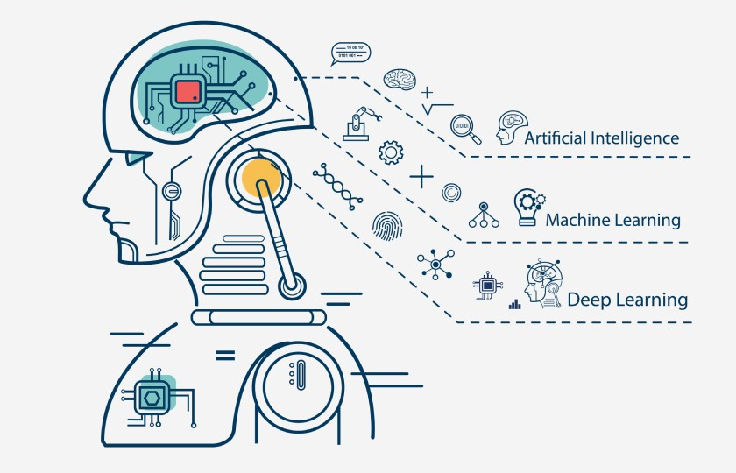
Our plan
Find a topic we want
Fun enough to want to do it
Challenging enough for good grade
Enough resources online
realistic wrt capabilities
Start on the project
We want to have a higher pace than the current schedule made by the teacher. So we will attempt this. Also weekly meetings.

